Slide 1
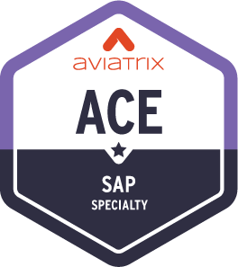
Aviatrix Certified Engineer (ACE)
SAP Specialty

Slide 2
Course Introduction
SAP is the leading enterprise resource planning (ERP) software
SAP specialty training is the starting point to support SAP migrations to the public cloud
SAP requires business-critical infrastructure to optimize uptime, performance, security, and cost.
Enterprises must address intelligent networking, compliance, security, high availability, and operational visibility need.
Enterprises demand a simple, consistent way to connect multiple regions, multiple-clouds and seamlessly extend the cloud operation model down to on-premises.
Target Audience
Networking and Security Engineers/Architects
SAP BASIS Engineers/Architects/Consultants
The training focuses on SAP S/4HANA common design patterns from a multicloud networking and security perspective, traffic flows between various SAP system components, and common networking and security use cases.
Consistent survey feedback from Admins/Engineers/Architects

Slide 3














































Iconic Enterprise Brands Choose Aviatrix for Cloud Networking
550+ Enterprise Customers, 60 Global Fortune 500

Slide 4























Big Brands Betting Big on ACE

Slide 5
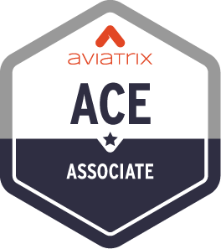
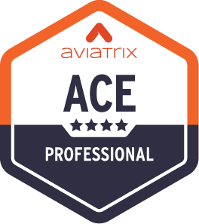


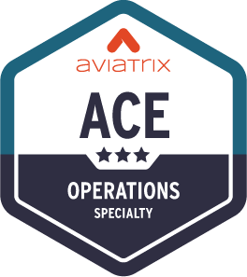
ACE Multicloud Networking Certification Program
Standard Learning Path
The Aviatrix Certified Engineer (ACE) Program is the industry’s first and only multicloud networking certification.
Its comprehensive training and specialized courses provide a deep understanding of building, operating, automating, scaling, and securing multicloud networks across AWS, Azure, Google Cloud, Oracle Cloud Infrastructure, and more.
The ACE Program ensures participants are equipped with best practices that span all major cloud providers, as well as the Aviatrix Cloud Networking Platform.
6 Hours
Learn CSP networking basics and review Aviatrix features
3 Days
Deploy proven design patterns for a multicloud network architecture
Weeks
Design a highly available, scalable, and secure multicloud architecture
Optional Specialty Trainings
6 Hours
Learn CSP networking basics and SAP fundamentals with a focus on S/4HANA
4 Hours
Use IaC tools to build, enhance, and secure infrastructure
8 Hours
Troubleshoot real-world Day 2 cloud issues​

Slide 6




Expectations from Today’s Session
Course Theme
High-level discussion on public cloud and SAP challenges
No deployment or configuration-related discussion
Public Cloud and SAP 101
Basics of AWS, Azure, and GCP for SAP BASIS and Networking Engineers/Architects
Cloud Networking and SAP S4/HANA 101
Fast Paced & Focused
A lot of concepts – can be overwhelming!
Infrastructure challenges for Network Engineers in Public Cloud managing S4/HANA
Learning and Engage
The self-paced course at https://aviatrix.com/ace
Aviatrix Community page: https://community.aviatrix.com
Aviatrix YouTube page: https://www.youtube.com/c/AviatrixSystems

Slide 7
ACE SAP Specialty Course Agenda
Topics | Approx. Dur
Course Intro | 0:10
Aviatrix Introduction | 0:15
AWS Networking 101 | 0:15
Break | 0:10
Azure Networking 101 | 0:15
GCP Networking 101 | 0:15
Multicloud Network Architecture | 0:10
Break | 0:10
SAP S4/HANA 101 | 0:30
SAP Cloud Designs without Aviatrix | 0:30
SAP Cloud Designs with Aviatrix | 0:60
Break | 0:10
Day2 Operations and Visibility | 0:30
Next Steps/Closing | 0:10
Labs | 0:60
Meet the Presenters
Aviatrix Team:
Luke Bockelmann
Shahzad Ali
Nauman Mustafa
Notes:
Unhide in instructor-led

Slide 8

Aviatrix Certified Engineer (ACE)
COMMUNITY
https://aviatrix.com/ACE
https://community.aviatrix.com

